Slide 1

Group: 7 Student names: Rashid Abdul Rahiman, Ameya Mote, Nanma Joseph, Kaushal Dabhi Student numbers: 3104875, 3104966, 3104969, 3105065
Technology Project Presentation
My-Voice Analysis +
Speech Synthesis With Python
Big Data & AI Group
Notes:
Describing about :
Speech syntheis
Use of diphones and triphones
Differnt methods of speech synthesis
Obstacles found while using it
Google text to speech system
Examples of gtts system
Adjusting audio speed with gtts system
Image to text to speech
My voice analysis
Basic Codes and examples
Future scope

Slide 2
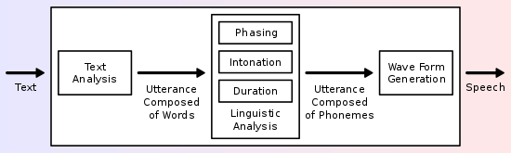
Speech Synthesis
Speech Synthesis is the artificial production of human speech. The system used for this purpose is called the Speech Synthesiser.
A text-to-speech (TTS) system converts normal language text into speech.
Synthesized speech can be created by concatenating pieces of recorded speech that are stored in a database, which may be phones, di-phones or tri-phones.
Overview of a typical Text To Speech (TTS) System

Slide 3
Di-phones & Tri-phones
In phonetics and linguistics, a phone is any distinct speech sound or gesture, regardless of whether the exact sound is critical to the meanings of words.
In contrast, a phoneme is a speech sound in a given language that, if swapped with another phoneme, could change one word to another.
A diphone is an adjacent pair of phones in an utterance. It is usually used to refer to a recording of the transition between two phones.
A triphone is a sequence of three phonemes. Triphones are useful in models of natural language processing where they are used to establish the various contexts in which a phoneme can occur in a particular natural language.
In Speech Synthesis we use di-phones and tri-phones because when pre-recorded diphones are combined to create synthesized speech, the resulting sounds are much more natural than combining just simple phones, because the pronunciations of each phone varies based on the surrounding phones.

Slide 4
Speech Synthesis
Speech synthesis basically does :
- Text to words
- Words to phonemes
- Phonemes to sound
TTs system consists of 2 parts:
- Front end
- Back end

Slide 5
Speech Synthesis
Front-end
It does 2 tasks:
Converts basic raw text having numbers, abbrevationsè⇒ written out words which is called text normalisation, preprocessing, tokenisation .
It then assigns phonetic transcriptions to each word, and divides and marks the text into prosodic units, like phrases, clauses, and sentences.
The process of assigning phonetic transcriptions to words is called text-to-phoneme or grapheme-to-phoneme conversion.
Back-end
Basically known as synthesiser
Converts linguistic representation ⇒ sound
This Part includes pitch contour and phoneme durations which are imposed on output speech .

Slide 6
Synthesis Method
A synthesizer algorithm is mainly divided into two parts : 1. Storage of Speech Parameters (Earlier mentioned di-phones & tri-phones) obtained from natural speech Theoretically, English needs about 1444 di-phones (38x38 which is all combinations of pairwise phonemes and silence), but in practicality, 1200 are enough to get the job done.
2. Program to concatenate these parameters into a sentence
Depending on the input from the user, we concatenate these speech di-phones and tri-phones to generate meaningful words and sentences.

Slide 7
Some Obstacles Faced
Breaking arbitrary speech into it’s constituent phonemes is only a partially solved problem.
Recording phonemes for concatenation produces audio with unnatural cadence and intonation, along with splicing artifacts.
The concept of smoothening, time-scaling and pitch correction works well in theory, but translates poorly into real world data, especially when concatenating multiple individual phonemes or diphones/triphones.
Another obstacle faced is the fact that there already exists allophonic variation in sounds based on accents, and surrounding phonemes.
Hence, to fully synthesise even a low-quality speech, we need a detailed understanding of the target’s language, accent and speech patterns.

Slide 8
Google Text To Speech (gTTS)
Google Text To Speech (gTTS) is an available API in Python which is used to convert text into speech. gTTS is a very easy to use tool which converts the text entered, into audio which can be saved as a mp3 file.
Customizable speech-specific sentence tokenizer that allows for unlimited lengths of text to be read, all while keeping proper intonation, abbreviations, decimals and more.
Customizable text pre-processors which can, for example, provide pronunciation corrections.
The audio can also be a file-like object (bytestring) for further audio manipulation.
gTTS supports 31 languages including English, German, Hindi, French, Spanish etc
Notes:
GttS developed by google basically which helps to translate any language text into a speech in any desired language.They are the smallest units of sound in our language. For example, the phonemes in “chick” are /ch/i/k/. Note that there are 5 letters but only 3 sounds. The phonemes in “big” are /b/i/g/. There are 3 letters and 3 sounds. In “dinosaur” the phonemes are /d/i/n/o/s/au/r/. There are 8 letters and 7 sounds. How confusing!!! This is why you should only teach up to 3 phonemes (or sounds) at this age level.

Slide 9
gTTS Languages Supported (Cloud)
Arabic | Filipino | Indonesian | Portuguese (Portugal)
Czech | Finnish | Italian | Russian
Danish | French (Canada) | Korean | Slovak
Dutch | French (France) | Japanese | Swedish
English (Australia) | German | Mandarin | Turkish
English (UK) | Greek | Norwegian | Ukrainian
English (India) | Hindi | Polish | Vietnamese
English (USA) | Hungarian | Portuguese (Brazil)

Slide 10
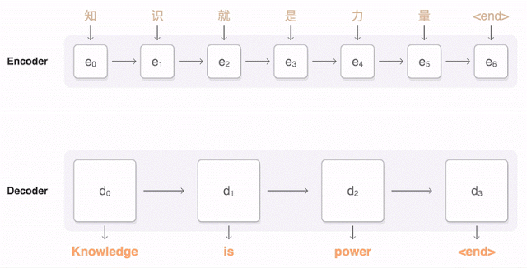
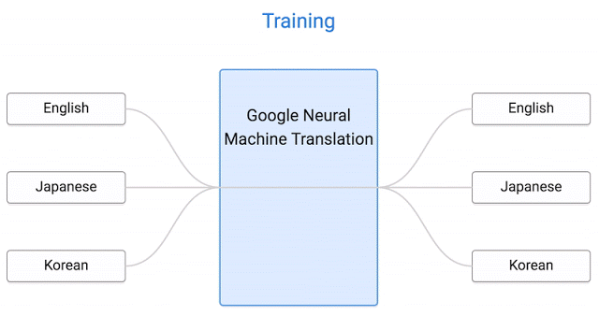
Google Text To Speech (gTTS)
Fig. 1 Encoding and Decoding
Fig. 2 Training

Slide 11
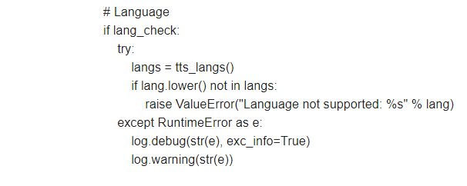
gTTS Source Code Explained
Checks if written language is supported or not.
Even if language is supported,run time error is shown if it fails to load from dictionary.
30+ different languages supporter

Slide 12
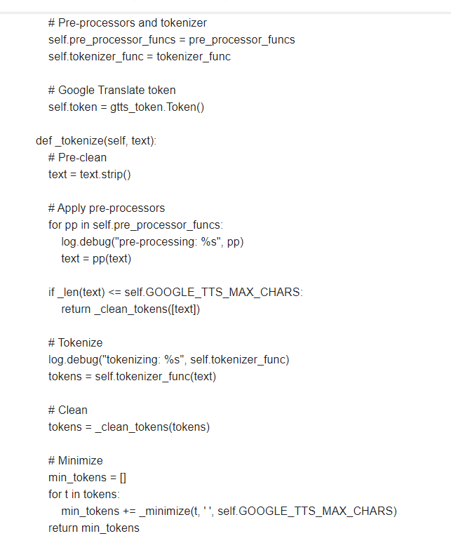
gTTS Source Code Explained
Pre-Processors: This function takes a written text and returns a text. It changes text and prepares it for tokenization
Tokenization: It breaks a given text into smaller pieces so that it does not exceed the limit of the translator of 100 words.
Clean_Func: It removes punctuation,Filters non alphabetic tokens,makes text ready for speech conversion
Min_tokens: Restricting the minimum numbers of tokens to 100 which is the limit of the google translate.

Slide 13
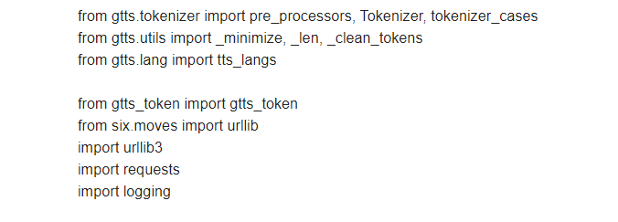
gTTS Source Code Explained
Imports different libraries for implementation of code.
Urllib: Used when many modules with URLs need to be declared inside the function.
Logging: To track the time and events.
Requests: To send out and receive requests for text to speech conversion.

Slide 14
gTTS Source Code Explained
Tokenization
It provides a lexical scanner for any python source code.
Helps in breaking of text into smaller segments.
Shallow Tokenization: Returns the text as string where every token is separated by a space.
Deep Tokenization: Returns the token as well as more information extracted from the text.

Slide 15
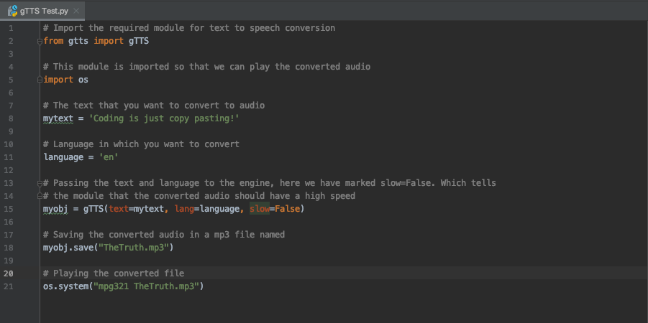
Simple Example using gTTS
Simple example of Text to Speech using gTTS

Slide 16
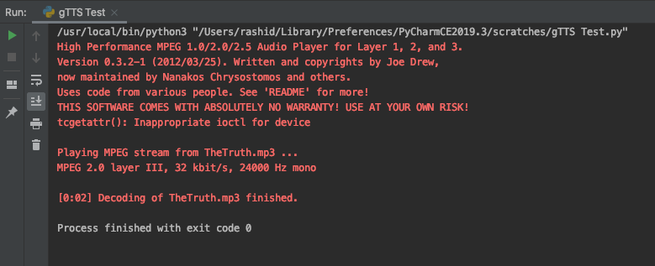

Simple Example using gTTS
Resultant Audio
Result is an audio played via mpg321 (Command line MP3 player)
Notes:
1

Slide 17
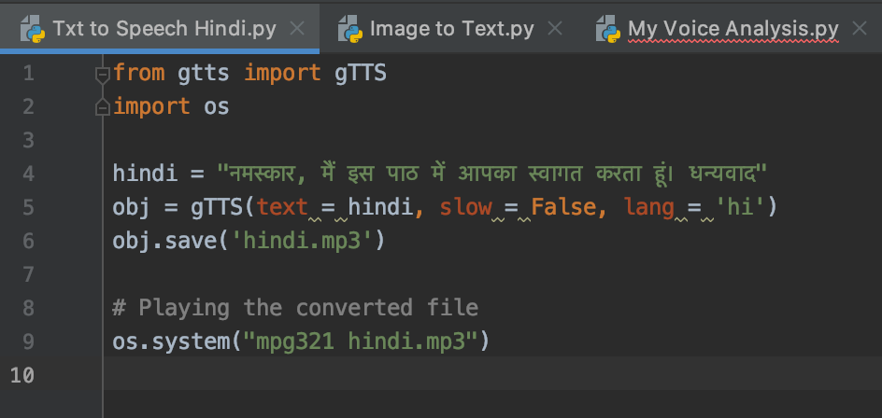
Hindi Text to Speech using gTTS
The Text saved is in Hindi, and language set to ‘hi’
Notes:
1

Slide 18
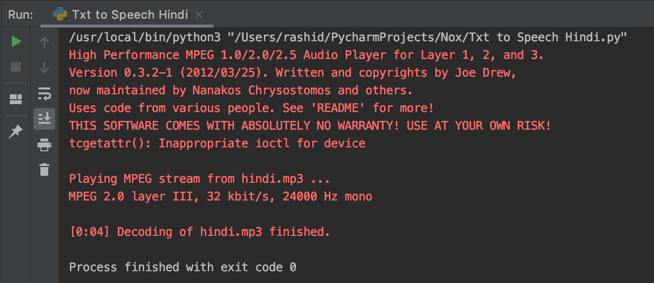
Hindi Text to Speech using gTTS
The resulting audio is read in a Hindi dialect
Notes:
1

Slide 19
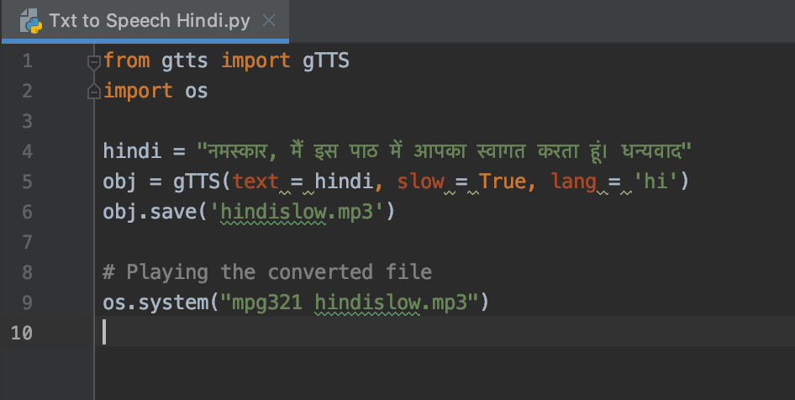
Adjusting Audio Speed with gTTS
Slow is set to True
Notes:
1

Slide 20
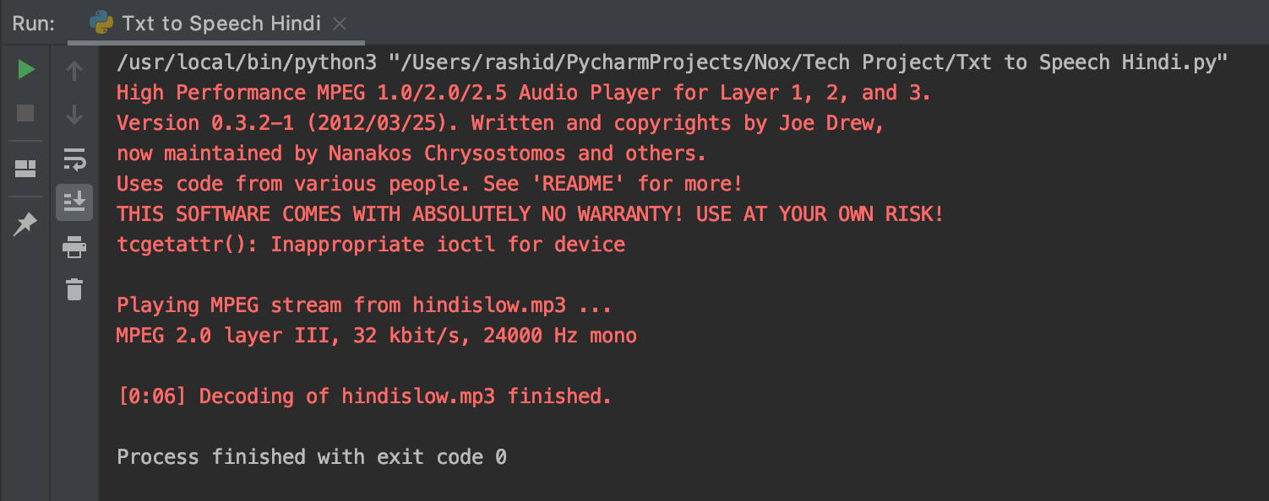
Adjusting Audio Speed with gTTS
Resulting audio is read slowly
Notes:
1

Slide 21
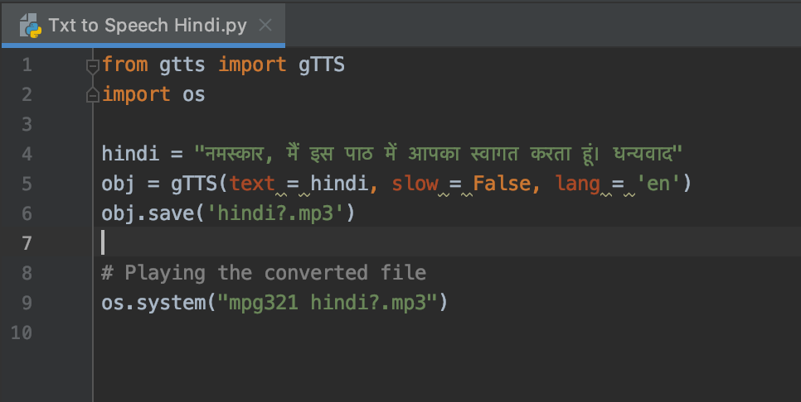
What happens when you set ‘en’ for Hindi text?
Notes:
1

Slide 22
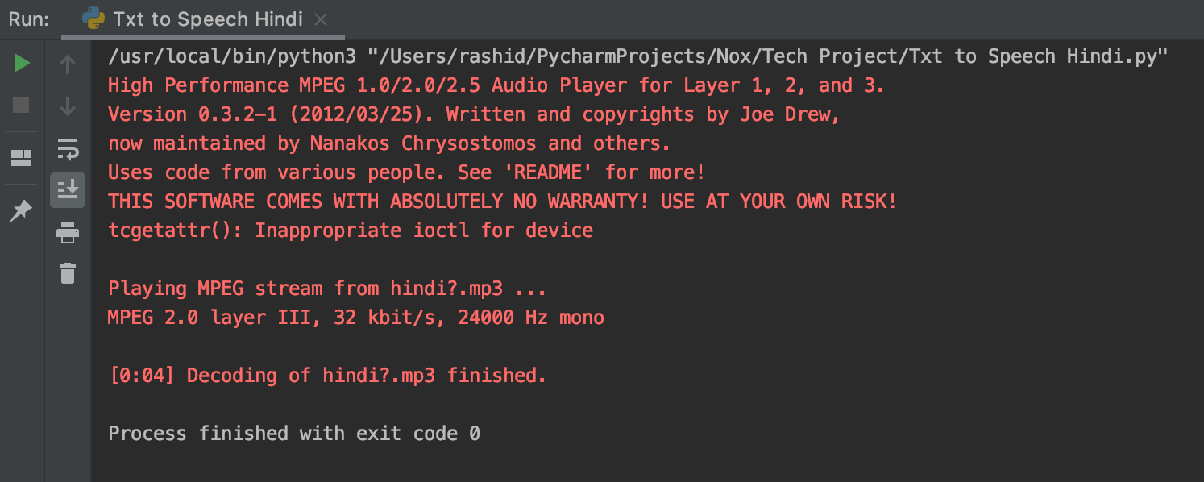
What happens when you set ‘en’ for Hindi text?
The resulting audio is read in an English dialect
Notes:
1

Slide 23
What happens when you set ‘de’ for Hindi text?
The resulting audio is read in an German dialect
Notes:
1Breaking arbitrary speech into its constituent phonemes is only a partially solved problem: speech-to-text software is still imperfect, as is text-to-speech.
The idea is to reproduce the timbre of the target's voice. Even if you were able to segment the audio perfectly, reordering the phonemes would produce audio with unnatural cadence and intonation, not to mention splicing artifacts. At that point you're getting into smoothing, time-scaling, and pitch correction, all of which are possible and well-understood in theory, but operate poorly on real-world data, especially when the audio sample in question is as short as a single phoneme, and further when the timbre needs to be preserved.
These problems are compounded on the phonetic side by allophonic variation in sounds based on accent and surrounding phonemes; in order to faithfully produce even a low-quality approximation of the audio, you'd need a detailed understanding of the target's language, accent, and speech patterns.
Furthermore, your ultimate problem is one of social engineering, and people are not easy to fool when it comes to the voices of people they know. Even with a large corpus of input data, at best you could get a short low-quality sample, hardly enough for a conversation.
So while it's certainly possible, it's difficult; even if it existed, it wouldn't always be good enough

Slide 24

Text in an Image to Speech
Part 1 : Image to Text
We aim to take the text from this image, and convert it into Speech

Slide 25
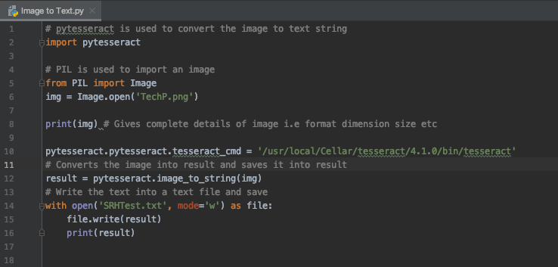
Text in an Image to Speech
Part 1 : Image to Text
Simple Code to recognise text in image
Notes:
Python-tesseract is an optical character recognition (OCR) tool for python. That is, it will recognize and “read” the text embedded in images. It is mainly used for scanned documents.
PIL Python Imaging Library

Slide 26
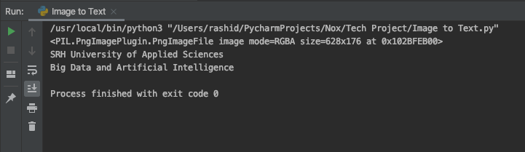
Text in an Image to Speech
Part 1 : Image to Text
Output shows that the text has been recognised

Slide 27
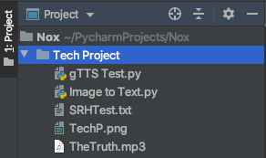
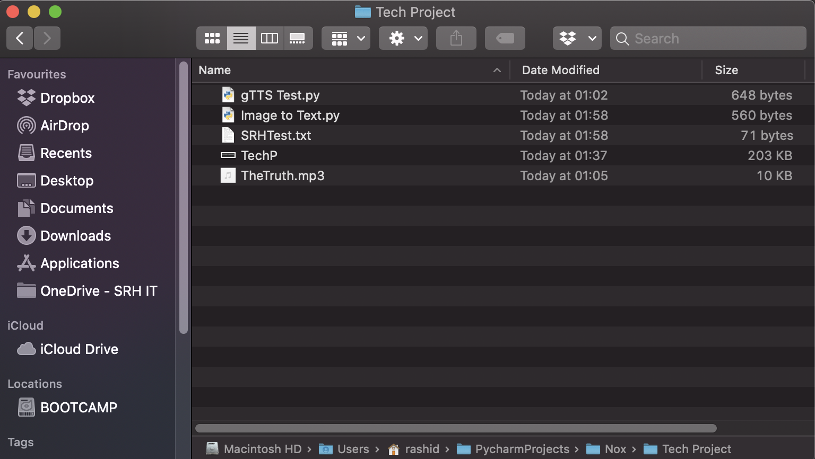
Text in an Image to Speech
Part 1 : Image to Text
Text has also been saved in txt file called SRHTest in directory

Slide 28
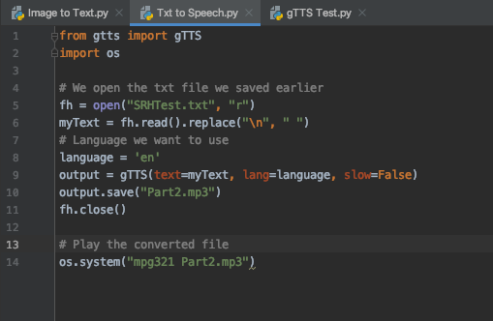
Text in an Image to Speech
Part 2 : Text to Speech
Code takes the txt file we saved in Part 1 and converts it into audio and plays it

Slide 29
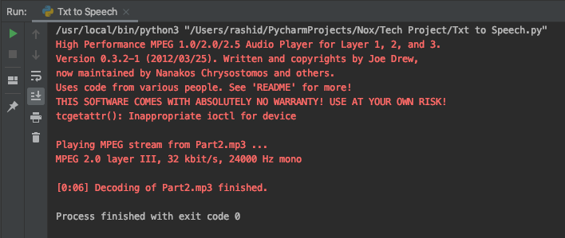
Text in an Image to Speech
Part 2 : Text to Speech
Resultant Audio
Output i.e audio is played. Therefore, we recognised text from an image and converted to speech

Slide 30
Python Text to Speech (pyttsx3)
pyttsx3 is a Python package supporting common text-to-speech engines on Mac OS X, Windows, and Linux.
Installed with pip install pyttsx3
Unlike gTTS, it works offline, and is compatible with both Python 2 and 3.
pyttsx3 includes the tts synthesizers of nsss, espeak(Open Source engine) and sapi5 (Microsoft)
Features like audio speed, voice (gender) and volume can be adjusted using pyttsx3
pyttsx3 however, does not have a direct method to save the resulting audio into an mp3 or wav file, unlike gtts
Notes:
gTTS is great, but it requires online access because it almost entirely depends on google. NSSS Mac, Sapi5 Windows and espeak on every other platform

Slide 31
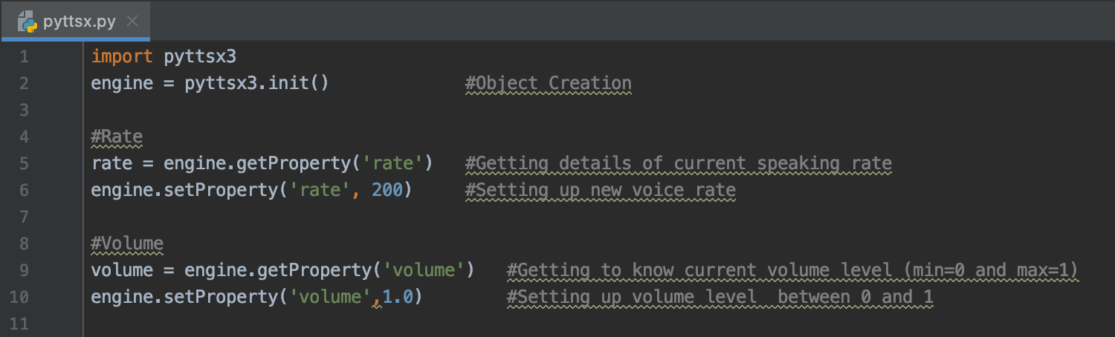
Adjusting Rate, Volume & Sound using pyttsx
We adjust the rate, and volume of the text to speech audio
Notes:
engine=pyttsx3.init() makes engine a reference to the pyttsx3 library.

Slide 32
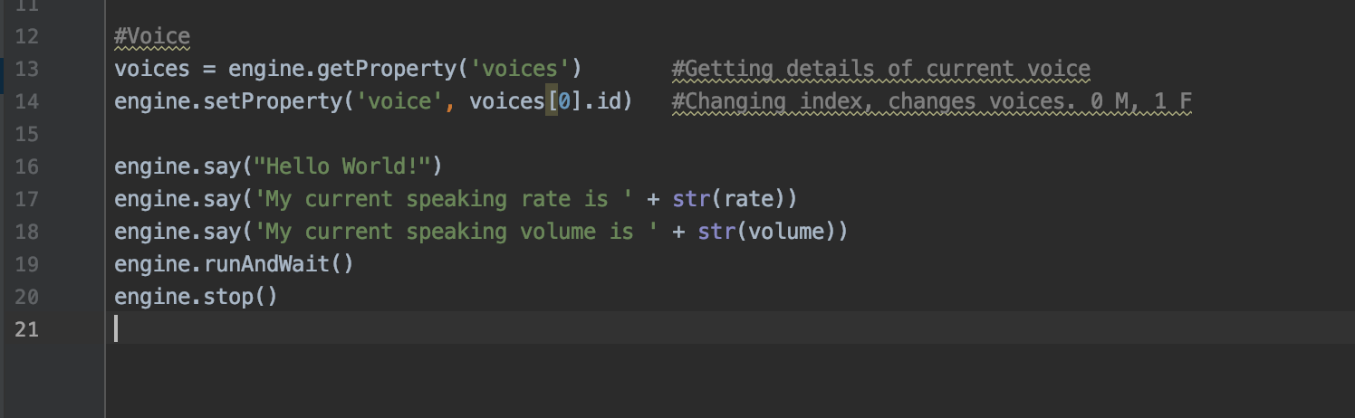
Adjusting Rate, Volume & Sound using pyttsx
We adjust the voice as well, to either a male or female

Slide 33
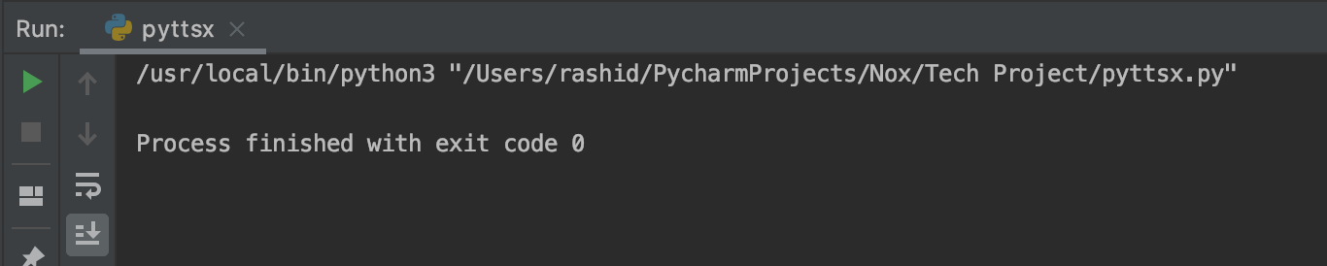
Adjusting Rate, Volume & Sound using pyttsx
The resulting audio is played as such

Slide 34
My-Voice Analysis
My-Voice-Analysis is a Python library for the analysis of voice (simultaneous speech, high entropy) without the need of a transcription. Installed with pip install my-voice-analysis
It breaks utterances and detects syllable boundaries, fundamental frequency contours, and formants.
Its built-in functions recognize and measures:
1. Gender Recognition - male/female
2. Speech Mood (Semantic Analysis) - Reading , p-value/sample size
3. Detect and count no of syllables eg: ‘water’ - 2 syllables
4. Detect and count no of fillers and pauses
5. Speech Rate eg : 3 syllables/sec
6. Measure speaking time excluding fillers and pause
7. Measure total speaking duration
8. Frequency statistics - mean, median,SD, quantiles.
Mainly used by linguists, scientists, developers, speech and language therapy clinics and researchers.
Notes:
Syllable : unit of pronounciation having one vowel sound, with or without surrounding consonants
Eg: 2 syllables in ‘water’ and 3 syllables in ‘inferno’

Slide 35
Praat-Parselmouth
Praat is a computer software made by Paul Boersma & David Weenink that helps with Phonetics on the computer, especially speech analysis.
Parselmouth is a Python Library for the Praat software.
Its built-in functions recognize and measures:
1. Harmonics to Noise Ratio
2. Amplitude
3. Frequency
4. Intensity
It can also be used to manipulate pitch by a number of octaves.
Installed by pip install praat-parselmouth

Slide 36
Analysis of the Wilhelm Scream
We now analyse the Wilhelm Scream using parselmouth. We try to understand the following :
Amplitude (m)
Frequency (Hz)
Intensity (dB)
Notes:
The Wilhelm scream is a stock sound effect that has been used in at least 416 films and TV series The scream is often used when someone is shot, falls from a great height, or is thrown from an explosion.

Slide 37
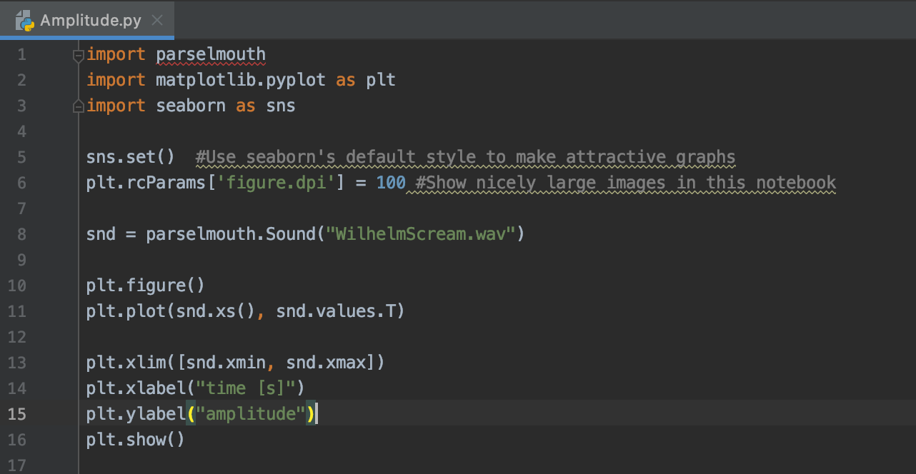
Amplitude Analysis
Notes:
Using Parselmouth, it is possible to use the existing Python plotting libraries – such as Matplotliband seaborn – to make custom visualizations of the speech data and analysis results obtained by running Praat’s algorithms.Parselmouth is currently in premature state and in active development. Seaborn is library for statistical data visualization extension of matplotlob

Slide 38
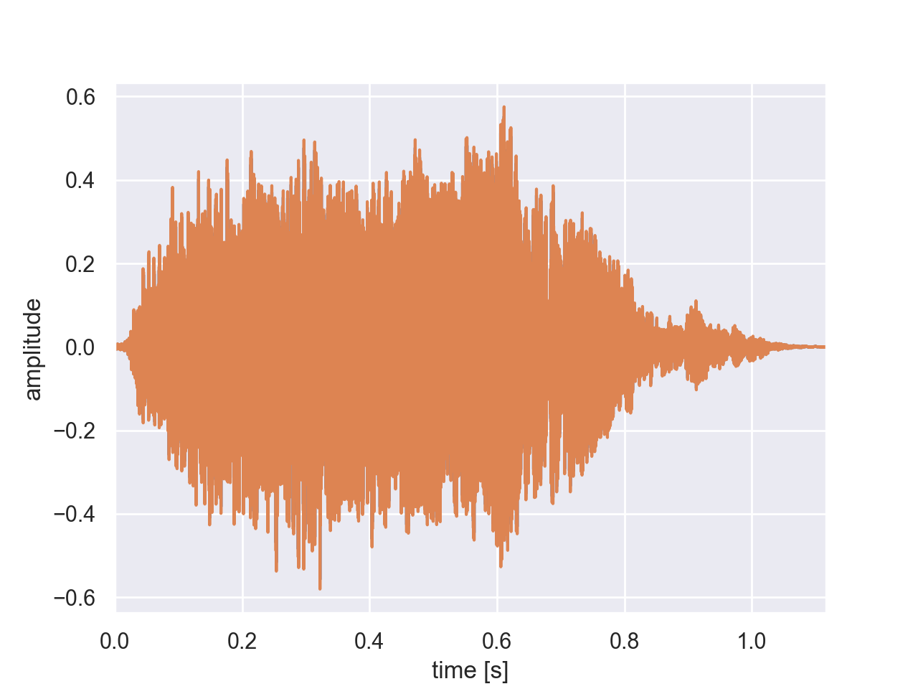
Amplitude Analysis
Notes:
Amplitude analysis - amplitude to time graph of wav file

Slide 39
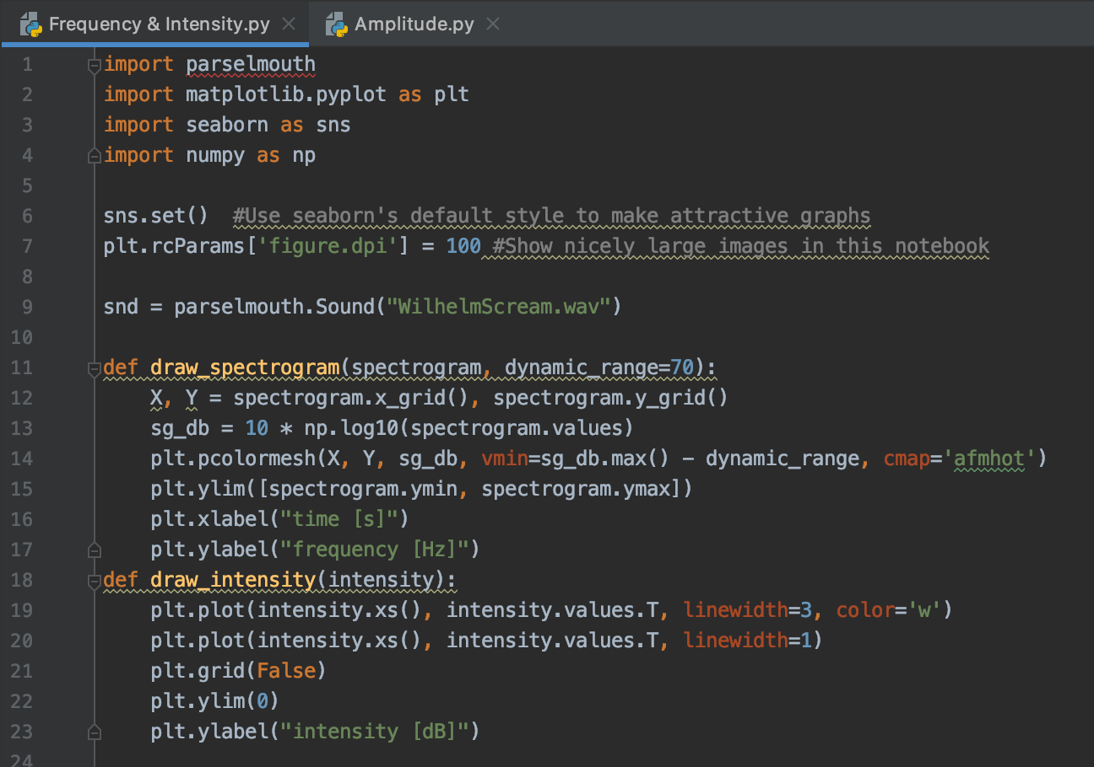
Frequency & Intensity Analysis
Spectogram function definition to display frequency of the Wilhelm Scream.
Intensity function definition to display the intensity of the Wilhelm Scream.

Slide 40
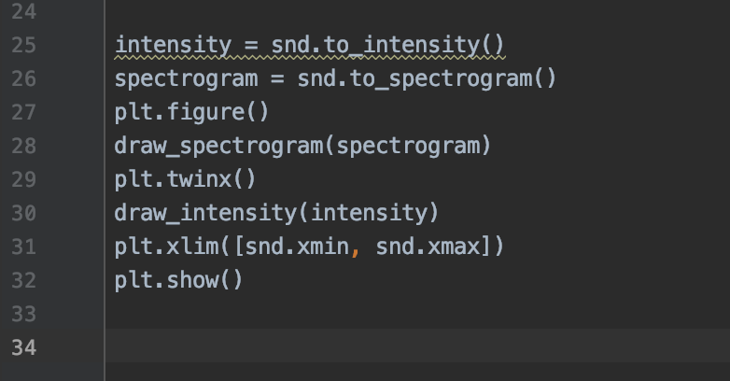
Frequency & Intensity Analysis
Notes:
Plt.twinx - two x axes

Slide 41
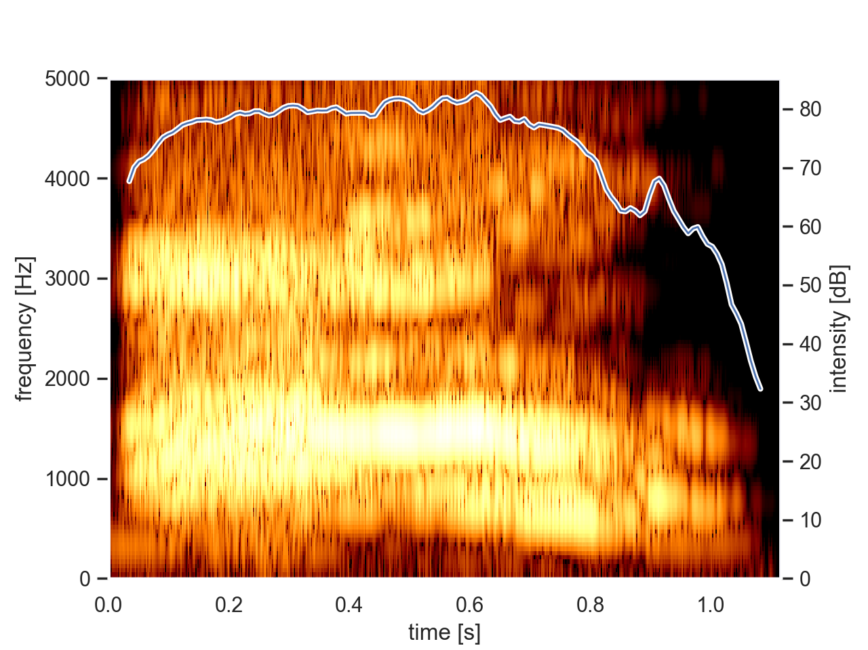
Frequency & Intensity Analysis
We use Praat (through Parselmouth) to calculate the spectrogram and intensity to actually plot the intensity curve overlaid on the spectrogram.

Slide 42
Obstacles with My-Voice Analysis
Audio files are in *.wav format, recorded at 44 kHz sample frame and 16 bits of resolution are typically saved in the directory, for analysis.
However, when we execute the code, it is not locating the file and giving the error couldn’t locate the file or audio is not clear even though myspsolution.praat and .wav are in same folder.
This was the case for multiple .wav files.

Slide 43
Future scope of speech and voice recognition
The voice and speech recognition industry is witnessing a rapid technological advancements along with increasing adoption of advanced electronic devices which are anticipated to stimulate the voice and speech recognition market growth during the forecast period.
Voice biometrics used for security purposes help in giving access to authenticated users for performing a transaction.
Surging use of voice biometrics is one of a key factor driving the voice and speech recognition market.
The global voice and speech recognition market is segmented into several classifications including function outlook, technology outlook, vertical outlook, and regional outlook.
Based on the function outlook the voice and speech recognition market is categorized by voice recognition, speaker identification, speaker verification, speech recognition, automation speech recognition, text to speech. Furthermore on the basis of technology outlook the voice and speech recognition market is efficiently driven by AI-based, and non-AI based.

Slide 44
Outlooks
Functional Outlook - Voice recognition
Speaker identification
Speaker verification
Speech recognition
Automatic speech recognition
Text to speech
Technology Outlook - AI Based Non AI Based
Vertical Outlook - Automotive Consumer Education Enterprise

Slide 45
References
https://pypi.org/project/my-voice-analysis/
https://github.com/Shahabks/my-voice-analysis/blob/master/my-voice-analysis/__init__.py
https://cloud.google.com/text-to-speech/
https://en.wikipedia.org/wiki/Speech_synthesis
https://books.google.de/books?id=qXIyWMLnr-4C&pg=PA331&lpg=PA331&dq=di+phones+and+tri+phones+concatenation&source=bl&ots=RWEUuq9L48&sig=ACfU3U1FcwJFbZfgqE4Bv_qM4XNt-nzwkg&hl=en&sa=X&ved=2ahUKEwjXoOO1o6PmAhUCJlAKHZg-AkYQ6AEwB3oECAoQAg#v=onepage&q=di%20phones%20and%20tri%20phones%20concatenation&f=false
https://flaviocopes.com/speech-synthesis-api/
https://montana-ledger.com/voice-and-speech-recognition-market-demand-future-scope-including-top-players/115610/
https://parselmouth.readthedocs.io/en/stable/index.html
http://www.fon.hum.uva.nl/praat/

Slide 46
Danke !

